Slide 1
Demo Website Ponshop
Steven Tjayadi/535180085
Ivan Jairus/535180086
Lucas/535180095
Kenny Dwi Cahya/535180100

Slide 2
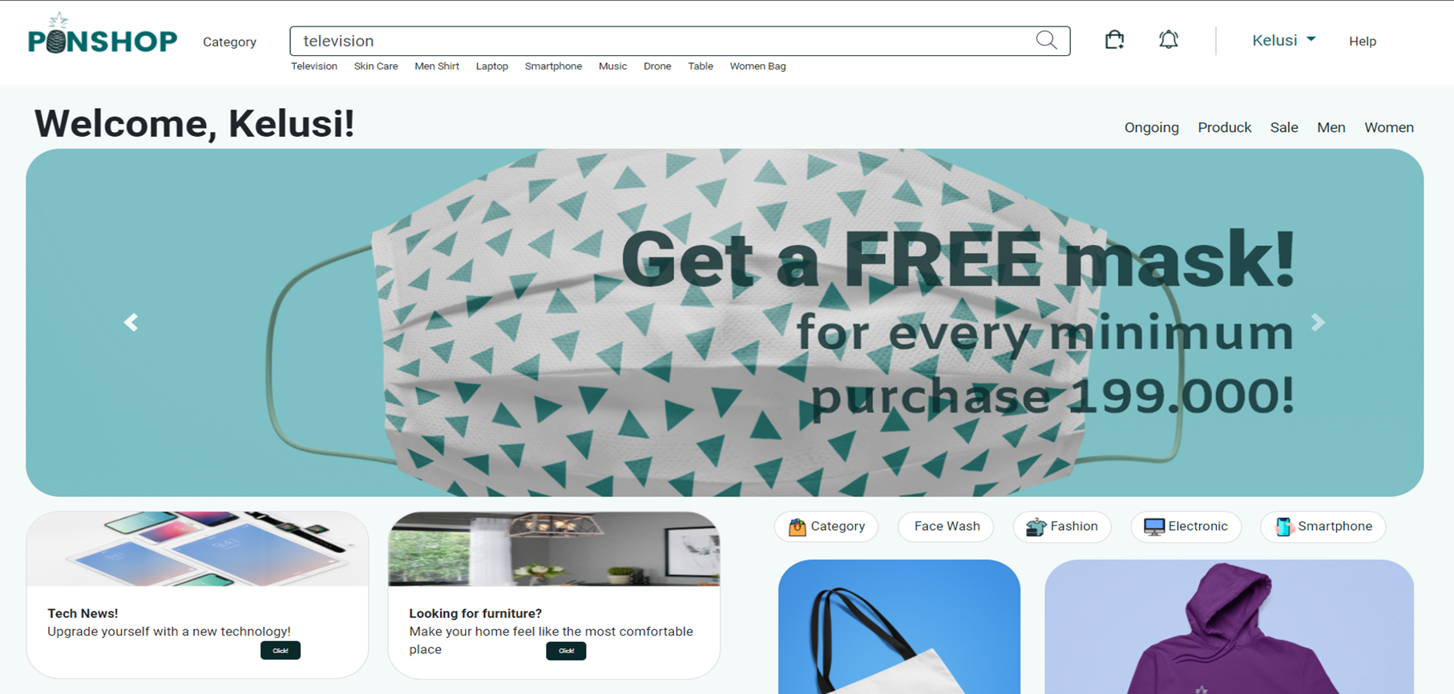
Homepage Ponshop

Slide 3
Documentation
Bootstrap CSS :
1. <link rel="stylesheet“ href= "https://stackpath.bootstrapcdn.com/bootstrap/4.3.1/css/bootstrap.min.css" integrity="sha384-ggOyR0iXCbMQv3Xipma34MD+dH/1fQ784/j6cY/iJTQUOhcWr7x9JvoRxT2MZw1T" crossorigin="anonymous">
2. <link rel="stylesheet" href="https://cdnjs.cloudflare.com/ajax/libs/font-awesome/4.7.0/css/font-awesome.min.css"> = untuk menambahkan star rating
3. <link href="https://fonts.googleapis.com/css2?family=Amiko:wght@400;600;700&display=swap" rel="stylesheet">
<link href="https://fonts.googleapis.com/css2?family=Roboto:wght@400;700;900&display=swap" rel="stylesheet">

Slide 4
4. <script src="https://code.jquery.com/jquery-3.3.1.slim.min.js" integrity="sha384-q8i/X+965DzO0rT7abK41JStQIAqVgRVzpbzo5smXKp4YfRvH+8abtTE1Pi6jizo" crossorigin="anonymous"></script>
5. <script src="https://cdnjs.cloudflare.com/ajax/libs/popper.js/1.14.7/umd/popper.min.js" integrity="sha384-UO2eT0CpHqdSJQ6hJty5KVphtPhzWj9WO1clHTMGa3JDZwrnQq4sF86dIHNDz0W1" crossorigin="anonymous"></script>
6. <script src="https://stackpath.bootstrapcdn.com/bootstrap/4.3.1/js/bootstrap.min.js" integrity="sha384-JjSmVgyd0p3pXB1rRibZUAYoIIy6OrQ6VrjIEaFf/nJGzIxFDsf4x0xIM+B07jRM" crossorigin="anonymous"></script>

